Slide 1


Space Tech for solving
SOLID WASTE MANAGEMENT
Team Name: Resonance
Team Leader’s Name: Malvika Dubey
Team Members: Malvika Dubey, R Dhiya Krishna, Imdad Aqueel
Institution: REVA University

Slide 2


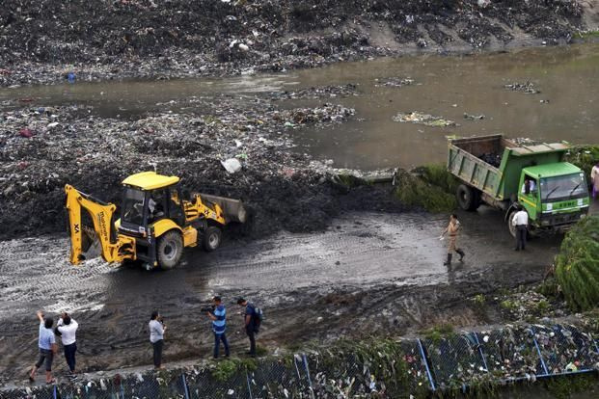
PROBLEM STATEMENT
Challenge :
Bengaluru generates over 5,000 tonnes of municipal solid waste daily, yet illegal dumping persists across peri-urban areas, lakebeds, and vacant layouts. These unmonitored dump sites release methane, contaminate soil and groundwater, and result in the loss of valuable recyclable materials.
Current systems rely on citizen complaints, manual inspections, and fixed-route waste collection, leading to delayed response, reactive management, and inefficient mixed-waste transportation.
Urgency/Relevance :
Mixed waste transport increases fuel wastage, carbon emissions, and reduces material recovery value, while the lack of intelligent pre-collection segregation limits efficient routing and resource recovery.
Absence of space-enabled, real-time ward-level monitoring prevents proactive detection of illegal dumping, and rapid urban expansion demands scalable, data-driven waste management solutions.

Slide 3
PROPOSED SOLUTION
OrbitClean – Space-Enabled Waste Intelligence for Circular Economy and Illegal Waste Dumping
Leveraging AI for waste classification and intelligent routing, OrbitClean provides advanced monitoring solutions to tackle illegal waste dumping and promote a circular economy at the ward level.
Key Features:
Expected Outcomes:
Satellite Detection: Identifies illegal dumping hotspots using open-source imagery.
AI Waste Classification: Segregates waste into Organic, Recyclable, Hazardous, and Residual categories.
Volume Estimation: Predicts waste scale and composition at each site.
Smart Vehicle Assignment: Optimized routing dispatches the correct collection vehicle.
Digital Traceability: Connects detection → classification → collection → recovery.
Early detection of illegal dumping, reducing landfill dependency and improving material recovery rates.
Lower greenhouse gas emissions and fuel usage through intelligent waste segregation and optimized routing.
End-to-end digital accountability, linking detection → classification → collection to enable traceable resource recovery.

Slide 4
TECHNOLOGY USED
Space & Geospatial Intelligence
AI & Intelligent Routing System
Sentinel-2 satellite imagery (Copernicus Open Access Hub)
ISRO Bhuvan portal for Indian geospatial layers
Google Earth Engine for satellite data processing
QGIS & GeoPandas for spatial analysis
Ward boundary & road network overlay
Hotspot mapping for illegal dumping detection
Python as core development language
YOLOv8 & OpenCV for waste image classification
Scikit-learn for ML modeling
Genetic Algorithm for route optimization
Flask / FastAPI for backend integration
Leaflet.js dashboard for map visualization

Slide 5
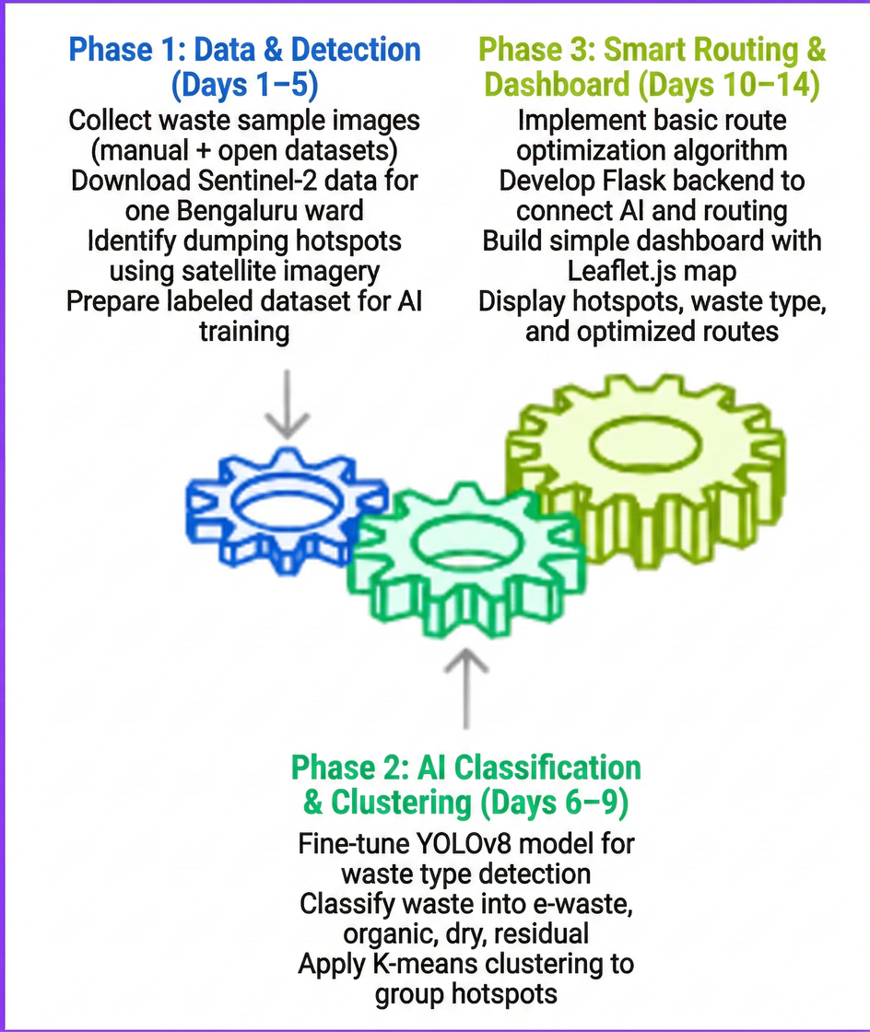
IMPLEMENTATION PLAN
Phase 1: Data & Detection (Days 1–5): Collect waste sample images from manual and open-source datasets and download Sentinel-2 satellite data for one selected Bengaluru ward. Identify potential dumping hotspots using satellite imagery and prepare a labeled dataset for AI model training.
Phase 2: AI Classification & Clustering (Days 6–9): Fine-tune the YOLOv8 model for waste type detection and classify waste into e-waste, organic, dry, and residual categories. Apply K-means clustering to group detected hotspots based on waste type and density.
Phase 3: Smart Routing & Dashboard (Days 10–14): Implement a basic route optimization algorithm to assign appropriate collection vehicles. Develop a Flask backend to integrate AI and routing modules, and build a simple Leaflet.js dashboard to display hotspots, classified waste types, and optimized routes.

Slide 6
HOW IT ALIGNS WITH THE CHALLENGE
Uses open-source satellite imagery to monitor peri-urban regions, lakebeds, and vacant layouts, enabling early identification of emerging waste hotspots and overcoming delayed manual inspections.
Illegal Dumping Detection
Intelligent Segregation & Recycling
AI-based image classification segregates waste into electronic, organic, recyclable, and residual streams at source, preventing loss of valuable materials and supporting circular economy goals.
Machine learning dynamically assigns specialized collection vehicles based on waste type and volume, reducing fuel consumption, operational costs, and carbon emissions compared to fixed-route systems.
Smart Route Optimization
Integrates GPS tracking, geotagged proof-of-collection uploads, and centralized dashboard monitoring to create a traceable and accountable waste management workflow.
Transparency & Accountability

Slide 7
THANK YOU

